Slide 1







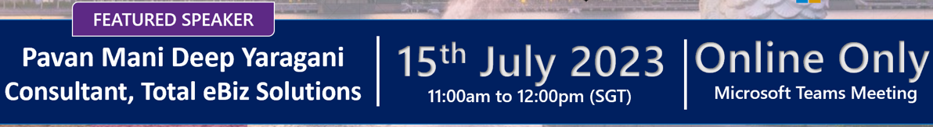


Unleashing the Power of Pipelines in Power Platform
Singapore Power Platform
User Group
Sponsored by
Powered by
#SGPowerPlatformUG

Slide 2
Pavan Mani Deep Y
Passionate Power Platform Consultant with 9 years of experience in to Dynamics CRM and Power Platform.
Working as Senior Technical Analyst in Total e-Biz Solutions PTE. Ltd.
Blog: https://ecellorscrm.com
LinkedIn: https://www.linkedin.com/in/pavanmanideep/
Twitter: https://twitter.com/EcellorsCrm

Slide 3
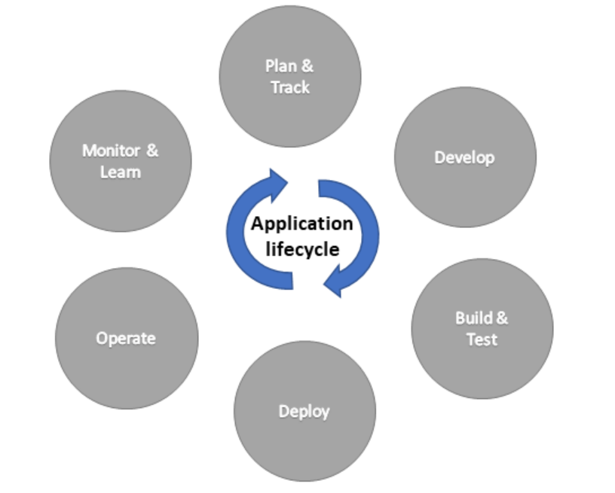
What is ALM?
ALM is the lifecycle management of applications, which includes the entire life cycle of your project.
Application Life Cycle Management is not just a set of tools, it covers
Application Development and Deployment
Software Testing
Operational Maintenance
Application Governance
Software Development Life Cycle(SDLC) only focuses on Software Development alone but ALM focuses on entire lifecycle of product.

Slide 4
Basics
Power Platform ALM consists of the following components
Environments
Solutions
Source Control
Automation
Licensing
Security

Slide 5
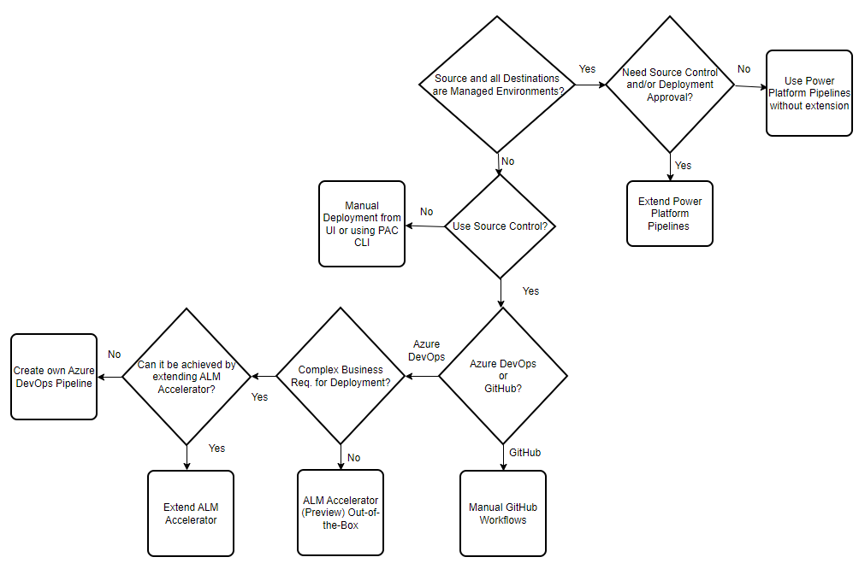
Making a choice while deployment
Pic Credit: Suparna Banerje, Cloud Solution Architect, Microsoft

Slide 6
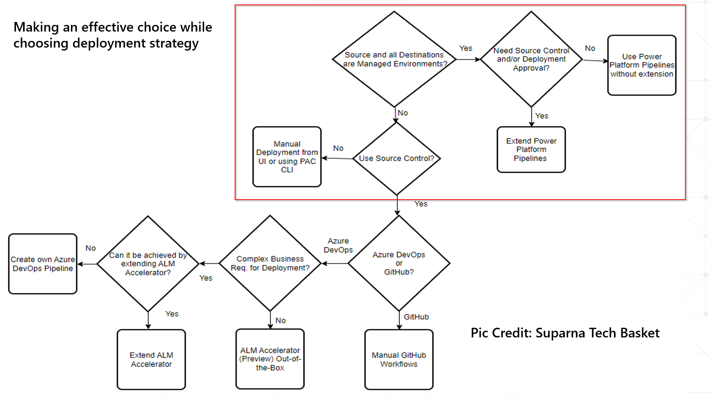
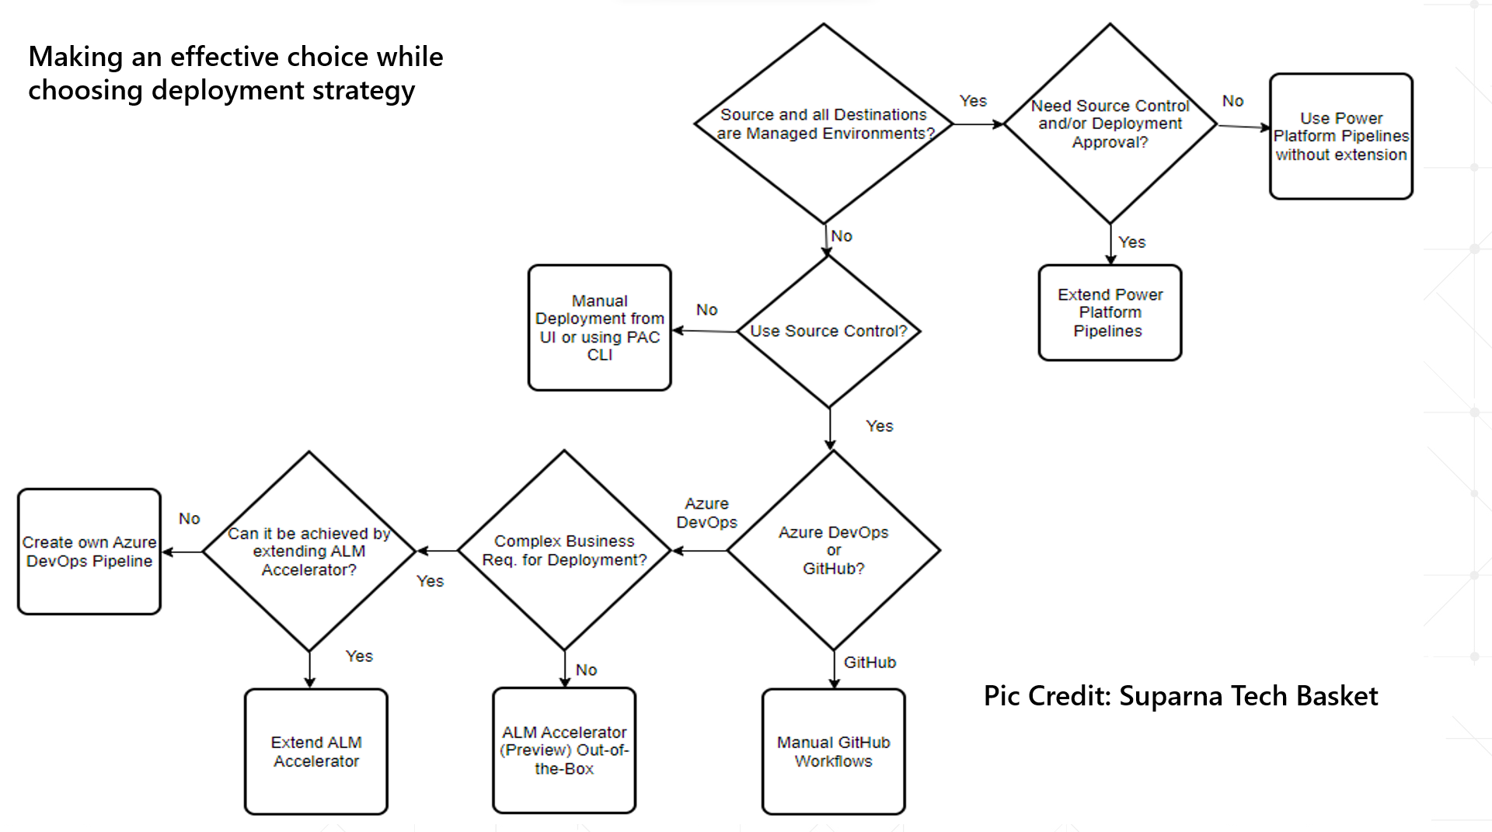
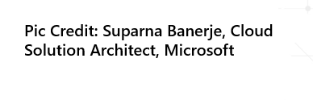
Making an effective choice while choosing deployment strategy
Pic Credit: Suparna Tech Basket

Slide 7
Type of ALM options in Power Platform
Power Platform Pipelines
Azure DevOps Pipelines by using Power Platform Build Tool tasks
Export-import solutions using PAC CLI - Pro Code
Install ALM Accelerator for Power Platform
GitHub Workflows by using GitHub actions for Power Platform
Manual export and import of Solutions from UI

Slide 8
Type of ALM options in Power Platform
Power Platform Pipelines
Azure DevOps Pipelines by using Power Platform Build Tool tasks
Export-import solutions using PAC CLI - Pro Code
Install ALM Accelerator for Power Platform
GitHub Workflows by using GitHub actions for Power Platform
Manual export and import of Solutions from UI

Slide 9
Automation using Power Pipelines in Power Platform
Why use Power Pipelines..?
Pipelines in Power Platform democratizes application lifecycle management (ALM) for Power Platform and helps Dynamics 365 customers by bringing ALM automation and continuous integration and continuous delivery (CI/CD) capabilities
Pipelines can be categorized based on end user usage primarily
Power Platform Pipelines – Low Code – Citizen Developer, Pro Dev
Power Platform Pipelines – Low Code – Citizen Developer, Pro Dev
CI–CD using Azure DevOps Pipelines – Pro Dev

Slide 10
Power Platform Pipelines
Ideal for small and medium sized businesses and mainly for start ups
All the environments participating in the ALM Process except Host Environment must be managed environments
Makes deployments smooth without manual intervention during deployment at odd times.
Create a Pipeline using simple steps
Easily share or manage the security aspect of Power Pipelines
Configure the pipeline in a easier manner and set up Pre and Post Deployment conditions
Optionally add Deployment notes to the deployment
Note: Power BI is not supported in Power Pipelines

Slide 11
Power Pipelines CI-CD Pipelines
Differences in the processes
Low Cost Of Ownership
All your Pipeline Configuration is stored in Host Environment as JSON
Centrally manage the Deployment activity across all environments and use OOB reports to track these
Set up Dataverse Triggers about when should the Pipeline run
Dependencies check and able to deploy patch solutions quickly
Configure pre, post deployment steps easily from UI
In depth technical knowledge required to maintain CI-CD Pipelines
Pipeline Configuration is stored in a YAML file in Repo
Deploy to different environments from a central git repository
You can specify triggers in UI or in YAML file about when the pipeline should run
Pre, Post Deployment steps to be configured programmatically

Slide 12
Managed Environments
Managed Environments is a suite of capabilities that allows to manage Power Platform at scale with more control, less effort, and more insights.
Enabling Managed Environment
Disabling Managed Environment
Licensing
Limit Sharing
Weekly Usage Insights
Data Policies
Set Up Power Platform Pipelines

Slide 13
Key Tables in Power Pipelines
Deployment Artifact
Deployment Environment
Deployment Pipeline
Deployment Stage
Deployment Stage Run
Deployment Stage Run Suboperations

Slide 14
Extend Pipelines in Power Platform
Add PreDeployment Conditions
Triggers
Trigger Conditions
Pro Developers can extend by using Power Apps CLI
Configure Approvals for the Deployments

Slide 15
Licensing requirements for using Power Pipelines
Environment purpose | Environment type | Standalone license required | Managed Environment
Host | Production | No | Recommended
Development | Developer | No | Yes
QA | Developer | No | Yes
Production | Production | Yes | Yes
Roles available for Power Pipelines:
Deployment Administrator
Deployment Pipeline User

Slide 16
Demo

Slide 17
Do you know..?
All Power Platform Components can be deployed using Power Pipelines?
Can we bypass deploying to QA Stage for Hotfixes?
What about licensing? What license should I have?
Approvals possible?
Can pipelines be developed in Default environment?
Is Update, Upgrade possible in target environment?
Deployment possible across Geo’s..
Can we Deploy Unmanaged Solutions?
Can we Deploy multiple solutions at once
Do we still need to publish customizations like we did manually
Is Impersonation possible?

Slide 18
Pros and Cons of using Power Pipelines when compared to Azure DevOps pipelines
Power Pipelines Azure DevOps Pipelines
Easier to maintain and takes very less effort to maintain
Pipelines can be effectively shared with the help of security roles to other makers
Can be extended further along with Azure DevOps and PAC CLI
Covers all the aspects which could be done via manual way.
Difficult to maintain
Apart from Power Platform Security, users need to be in Azure DevOps
Contains the repository where all the source code is stored
Ability to audit who changed which part of the code

Slide 19
Thank You!

